Slide 1



Chapter One Introduction
1.1 Preface
What is optical fiber?
Cladding
Core
n₁> n₂
n₂
SiO₂ Glass
θ
n₁
n₂
Primary coating
(e.g., soft plastic)
Typical structure
Total internal reflection
An optical fiber is a cylindrical dielectric waveguide made of low-loss materials such as silica glass. It has a central core in which the light is guided, embedded in an outer cladding of slightly lower refractive index.

Slide 2
The development of optical fiber
In 1870: Tyndall (UK) observed the phenomenon that if the flowing water was bent, some lights inside would be also bent as a result of total internal reflection at the water-air boundary.
In 1929 and 1930: Hanael (US) and Lamm (DE) drew the silica fiber to realize the light and image transmissions at a short distance, respectively.
Optical fiber is one kind of magical media for information transmission
Before 1966: The development of fiber based technologies were very slow due to the significantly high loss levels. (typically several hundreds or even more than one thousand dB/km)
In 1966: Dr. Charles Kuen Kao predicted the possibility of long-distance light transmission by the fiber.
In 1966: Dr. Charles Kuen Kao published an important and famous paper “Dielectric-fibre surface waveguides for optical frequencies”. He proposed that the silica fiber loss can be reduced significantly by improving the fiber drawing technology and reducing the impurity of raw material. Also he predicted the possibility of drawing the silica fiber with an loss level below 20 dB/km thus enabling fiber-based communication system. In 2009, Charls Kao won the Nobel Prize in physics because of his breakthrough achievements in fiber-based light transmission and its application in communication systems.

Slide 3
The milestone to the fiber communication development 里程碑
In 1970, Corning Glass Corporation (US) successfully drew the silica fiber with a low loss of 20 dB/km (@ 0.6328 µm) which firstly turned Kao’s prediction into the reality.
Further development of fiber communication
In the following 20 years, fiber loss was being lowered significantly from 1000 dB/km to 0.16 dB/km.
In 1972: 4 dB/km (Corning Glass Corporation).
In 1973: 2.5 dB/km (Bell Labs).
In 1974: 1.1 dB/km (Bell Labs).
In 1976: 0.47 dB/km@1.2 µm (Nippon telegraph and telephone company).
Nowadays: The fiber loss was reduced to is < 0.2 dB/km @1.55 μm.
In the end of 1980s, the invention of Er-doped fiber amplifier (EDFA) led the fiber communication to being a dynamic new industry.
The applications of optical fiber
Fiber communication systems
Fiber sensors
Fiber lasers

Slide 4
Fiber communication systems – 直接调制
Laser source
EDFA
Photodetector
Optical cable
Optical cable
Direct modulation / internal modulation
Electrical modulator
Signal
processing
Input
Destination
The light source is directly modulated, and the intensity of the laser output light wave is changed by controlling the size of the injection current of the semiconductor laser.
Advantage: Simple structure, small loss, low cost
Disadvantage:
Since the change of modulation current will cause the length of the laser luminescent resonator to change, causing the wavelength of the emitted laser to change linearly with the modulation current, this change is called chirping, which is actually a wavelength jitter that cannot be overcome by directly modulating the light source.
The presence of chirping broadens the bandwidth of the laser emission spectrum, deteriorates the spectral characteristics of the light source, and limits the transmission rate and distance of the system.

Slide 5
Fiber communication systems – 间接调制
Laser source
Optical modulator
EDFA
Photodetector
Optical cable
Optical cable
Indirect modulation
/ External modulation
Electrical modulator
Signal processing
Input
Destination
Indirect modulation separates the generation and modulation of the optical signal, it does not need to change the driving current of the laser, so it avoids the occurrence of frequency chirping, suitable for high-speed communication systems, it usually uses the electro-optic effect of the crystal, acousto-optic effect, magneto-optical effect and other properties to achieve the modulation of the laser.
The luminescence and modulation functions of the indirect modulation light source are separated, that is, the modulation signal is loaded after the laser is formed, and the two only have the link of the optical path and there is no mutual influence of the circuit, so the work of the laser will not be affected by modulation.
Direct modulation is suitable for semiconductor light source devices of the current injection type (电流注入型的半导体光源器件). Indirect modulation is suitable for the operation of various lasers.

Slide 6
Fiber communication systems
The advantages of fibers compared to wires (电线) and coaxial cables (同轴电缆) in communication systems :
(1) Quite broad transmission bandwidth
(2) Longer non-repeater communication distance as a result of low loss
(3) Excellent security and great anti-interference ability
(4) Compact, light, flexible, convenient
(5) Low cost
Fiber sensors applications
To monitor and early warn geological disasters and engineering safety
(a) Landslide 滑坡
(b) Petrochemical fire 石化火灾
(c) Electric-power fire 电力火灾
(d) Bridge collapse 桥梁坍塌
(e) Gas explosion 气体爆炸
(f) Coalmine explosion 煤矿爆炸
(g) Underground pipe network leakage 地下管网渗漏
(h) Ice coating of power network 电网冰涂层

Slide 7
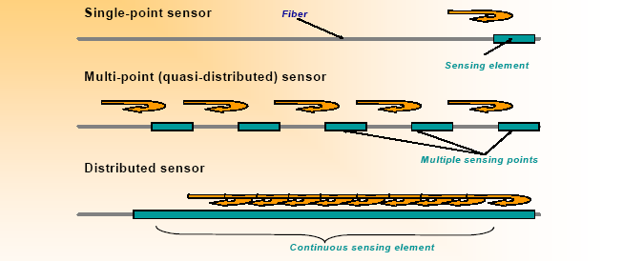
Fiber Sensors
Fiber communication
Fiber sensor
Fiber sensors are experiencing a fast development and have an comparable global market with fiber communication.
Types of fiber sensors:
Single-point sensor, Multi-point (quasi-distributed) sensor, Distributed sensor

Slide 8
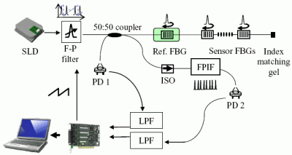
Types of fiber sensors:
(a) Fiber Bragg grating (FBG) based fiber sensors
The center reflectivity wavelength of one FBG would be changed by the stress or temperature
Application:
(1) Railway monitoring
(2) Bridge monitoring
When a broad-spectrum beam is propagated to the fiber Bragg grating, each small section of fiber after the light refractive index is changed will only reflect a specific wavelength of light waves, this wavelength is called the Bragg wavelength, and other wavelengths of light waves will be propagated. The change of strain and temperature will affect the effective light refractive index n and the grating period Λ of the fiber Bragg grating at the same time, resulting in a change in the wavelength of the light wave reflected by the grating.

Slide 9
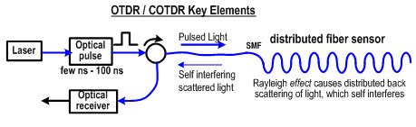
Types of fiber sensors:
Application: Gas pipe monitoring & Landslide monitoring
(b) Distributed fiber sensors
They are mainly based on Rayleigh scattering, stimulated Raman scattering (SRS), stimulated Brillouin scattering (SBS), etc.
stress or temperature
Distributed optical fiber sensing is based on optical fiber sensing technology that emits a variety of scattered light intensity, frequency and phase information in optical fiber, and the sensing unit is optical fiber. In addition to relying on optical fibers, the measured physical quantities rely more on modulation and demodulation equipment and algorithms, and the measured physical quantities are mostly the average physical quantities of the location of any section of optical fiber sensors.

Slide 10
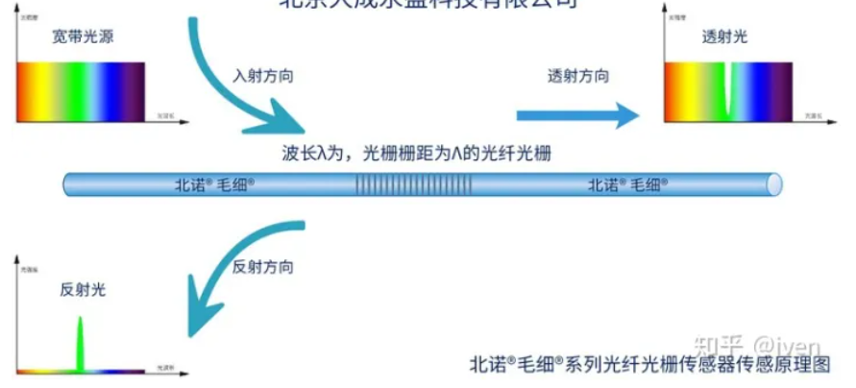
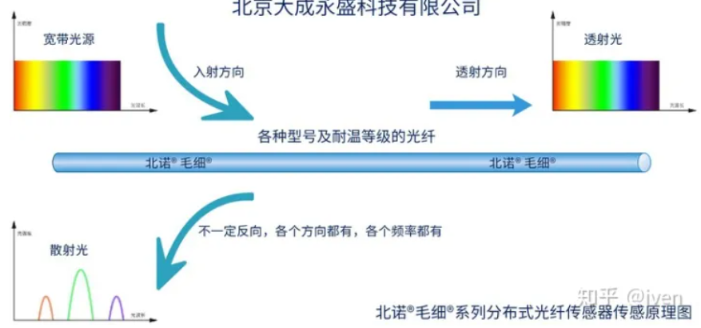
(b) Distributed fiber sensors
Similarly, broadband light emitted by fiber optic sensing devices enters the fiber from left to right, and the light is scattered due to impurities inherent in the fiber. You can simply understand that light collides with some inherent impurities in the optical fiber as particles, and the particles formed after the collision are ejected in all directions, and the frequency is much more, and these lights are collectively called scattered light. According to the different light frequency characteristics of the scattered light, these scatterings are Rayleigh scattering, Raman scattering, and Brillouin scattering. These scattered optical signals usually correspond to physical quantities such as location, temperature, stress, strain, vibration and other physical quantities in the environment where the fiber is located.

Slide 11
The advantages of fiber sensors compared to other sensors:
(1) High sensitivity
(2) Broad bandwidth and large dynamic measurement range
(3) Excellent security
(4) Light, compact, and bendable
(5) Compatible with fiber telemetry technology
(6) Convenient connection with computer
Fiber lasers
(1) Material processing (2) Micro surgery (3) Weapon
Lockheed Martin Shows Off High-Power Fiber Laser Weapon of 30 kW
The company claims that this latest achievement is “the highest power ever documented while retaining beam quality and electrical efficiency” and that the fiber laser consumes half the power of more conventional solid-state laser.

Slide 12
Fiber lasers
Fiber laser: a laser whose gain medium is an active fiber with rare-earth-ion dopant or high nonlinear fiber
Typical structures of fiber lasers
(1) Linear cavity
High reflectivity mirror
Low reflectivity mirror
Pump
Gain fiber
Laser output
(2) Ring cavity
Combiner
Isolator
Coupler
Pump source
Laser output
Gain fiber

Slide 13
Advantages of fiber lasers
Great beam quality
Excellent heat dissipation ability
High conversion efficiency
Compact and flexible structure
Easy to integrate
Low cost
1.2 Types of optical fibers
Types of optical fibers with different applications
Types of optical fibers with different host materials
Types of optical fibers with different structures
Specialty optical fibers

Slide 14
Types of optical fibers with different applications
In general, the optical fibers can be roughly classified according to the fact that whether they are used for communication or not.
Optical fibers for communications
They are commonly applied in the fiber communication systems
Optical fibers not for communications
They are mainly used for images transmission, fiber sensor, signal processing, energy transmission , etc.

Slide 15
Types of optical fibers with different materials
Silica fiber
  Host material: silica glass
  Lowest loss at near-infrared waveband can be obtained (0.16 dB/km @1.55 μm)
Plastic fiber
  Host material: optical plastic
  Quite light, excellent tenacity, low cost, easy fabrication
  The transmission loss is higher than silica fiber at the UV and near-infrared range
Infrared fiber
  Host material: fluoride or chalcogenide glass
  Significantly low theoretical loss limitation (typically 10⁻³ dB/km) especially at mid-infrared waveband.
  However, Compared to above fibers, the fabrication technology is not matured enough.

Slide 16
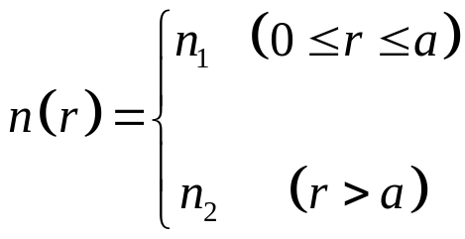
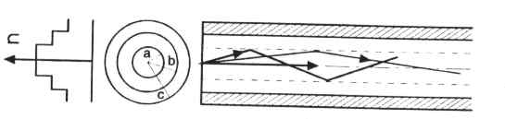
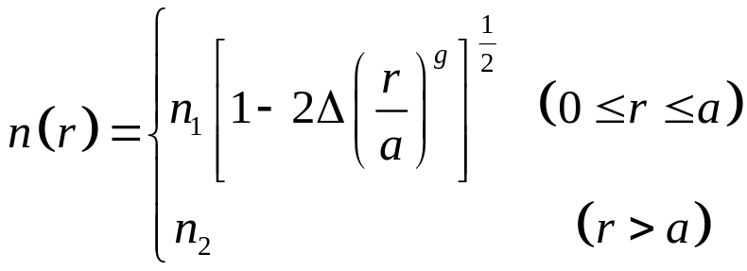
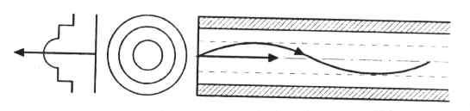
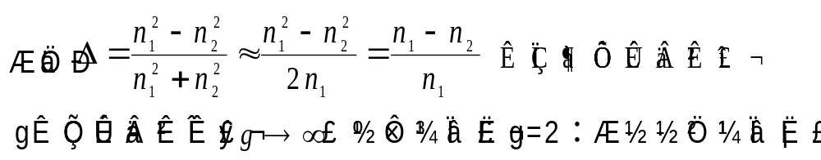
Types of optical fibers with different structures
(1) Step-index optical fiber (SIOF)
(core)
(cladding)
(2) Graded-index optical fiber (GIOF)
(relative refractive index difference)
g is the refractive index distribution parameter.
g→∞: step-index fiber; g=2: square-law index fiber

Slide 17
(1) Step-index optical fiber (SIOF)
Step-index multimode fiber
(a) Imaging fiber
Thin cladding with typical 20 μm core diameter
Limitation: Reducing fiber size can increase the resolutions of the images transmitted through a bundle, but fine fibers are hard to handle.
(b) Illuminating and Beam-Delivery fiber
Large core size of typical 400 μm ~1mm,
Limitation: the thicker fiber will lead to the less flexibility.
(c) Communications fiber
Not quite large core size of typical 100 (core)/140 (cladding) μm)
Limitation: the pulse-dispersion effect (i.e., modal dispersion) becomes larger with distance and would limit data transmission rate.

Slide 18
Step-index single mode fiber
Standard size: core diameter 8.6-9.5 μm, cladding diameter 125 μm, International Telecommunications Union (ITU) G.652
  It avoids the modal dispersion, modal noise and other effects that comes with multimode transmission.
  It is usually applied in high-speed and long-distance communication.

Slide 19
(2) Graded-index optical fiber (GIOF)
Graded-index multimode fiber
Standard size: core 50 or 62.5 μm, cladding diameter 125 μm.
50 μm core is the ITU G. 651 standard
cladding
core
Advantages: Nearly eliminate the mode dispersion with large core, giving them greater capacity, if the index function is well designed
Limitations: Other types of dispersion; different mode will interfere with each other generating modal noise.
This fiber is usually used in short system, even at higher speeds.

Slide 20
Specialty optical fibers
Zero-dispersion shifted fiber (Standard: ITU G.653)
Nonzero-dispersion shifted fiber (Standard: ITU G.655)
Dispersion compensation fiber (DCF) 色散补偿光纤
Polarization maintain fiber (PMF)
Active fiber
Double-cladding fiber
……
1.3 Silica Fiber Manufacture
(1) Understanding the structure of idea fiber
(2) Preform manufacture
(3) Fiber drawing
(4) Coating

Slide 21
1.3 Silica Fiber Manufacture
(1) Structure
Core
Core
(a) Matched cladding fiber
Depressed cladding
Cladding
Outer cladding
Core
Refractive Index
Cladding
(pure silica )
Doping Germania into the core to
increase the refractive index
(b) Depressed cladding fiber
Core
Fluorine is doped into the cladding to decrease its refractive index
Outer cladding
(pure silica)
Refractive Index
Depressed cladding
Less Germania is doped into
the core to increase its refractive index
These 2 are single mode fibers

Slide 22
1.3 Silica Fiber Manufacture
(c) Plastic cladding fiber
Core
Multimode fiber
Cladding
Core
(pure silica)
Refractive Index
Plastic cladding

Slide 23
1.3 Silica Fiber Manufacture
(2) Preform preparation
This is the trickiest stage in manufacturing fused-silica optical fibers (最棘手的一步)
The crucial common feature is the formation of fluffy fused-silica soot by reacting SiCl₄ (and GeCl₄) with oxygen to generate SiO₂ (and GeO₂). The crucial variations are in how the soot is deposited and melted into the final preform.
high temperature
oxidation
SiCl₄＋ O₂ SiO₂＋2Cl₂
high temperature
oxidation
GeCl₄＋O₂ GeO₂＋2Cl₂

Slide 24
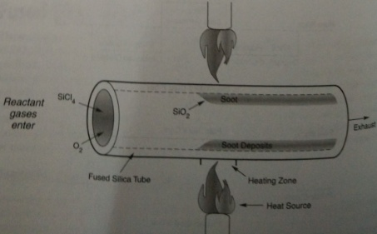
1.3 Silica Fiber Manufacture
Three different approaches to make preform
Modified chemical vapour deposition (MCVD)
Outside vapour depostion (OVD)
Vapour-phase axial depostion (VAD)
(1-MCVD) To deposit the soot on the inside wall of a fused-silica tube, here, the tube serves as the outer cladding, onto which an inner cladding layer and core glass are deposited.

Slide 25
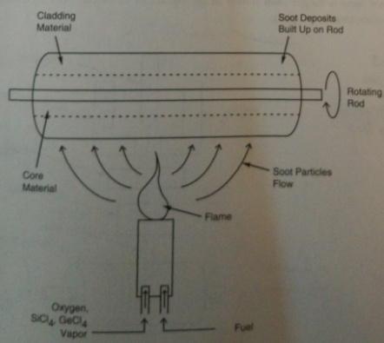
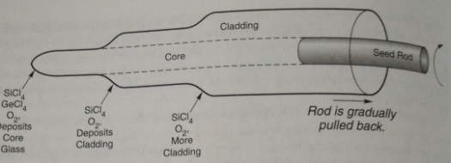
1.3 Silica Fiber Manufacture
(2-OVD) To deposit the soot on the outside of a rotating ceramic rod. The ceramic rod is not a part of the fiber, it is just a substrate. (右)
(3-VAD) In this case, a rod of pure silica serves as a “seed” for deposition of glass soot on its end rather than its surface. (下)
The three approaches above all yield long glass cylindrical rods called preforms. 预制棒

Slide 26
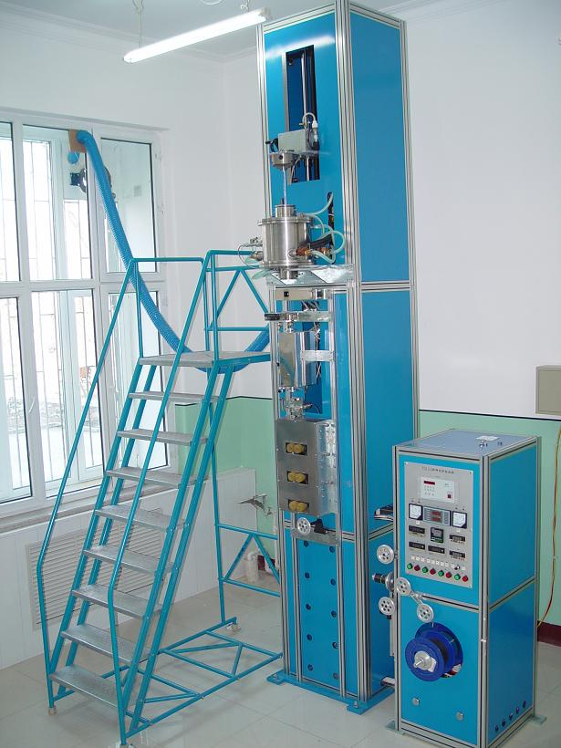
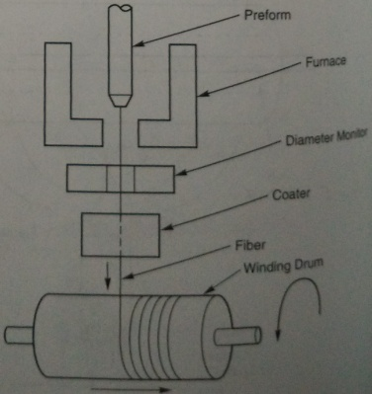
1.3 Silica Fiber Manufacture
(3) Drawing fibers
Optical fibers are drawn from performs by heating the glass until it softens, then pulling the hot glass away from the preform.
Drawing tower

Slide 27
1.3 Silica Fiber Manufacture
(4) Coating
To provide the mechanical strength of the fibers
Primary coating: polymer coating (涂覆)
Secondary coating: sleeve the fiber with e.g., polyethylene or polypropylene plastic, to improve the stretched strength

